Slide 1
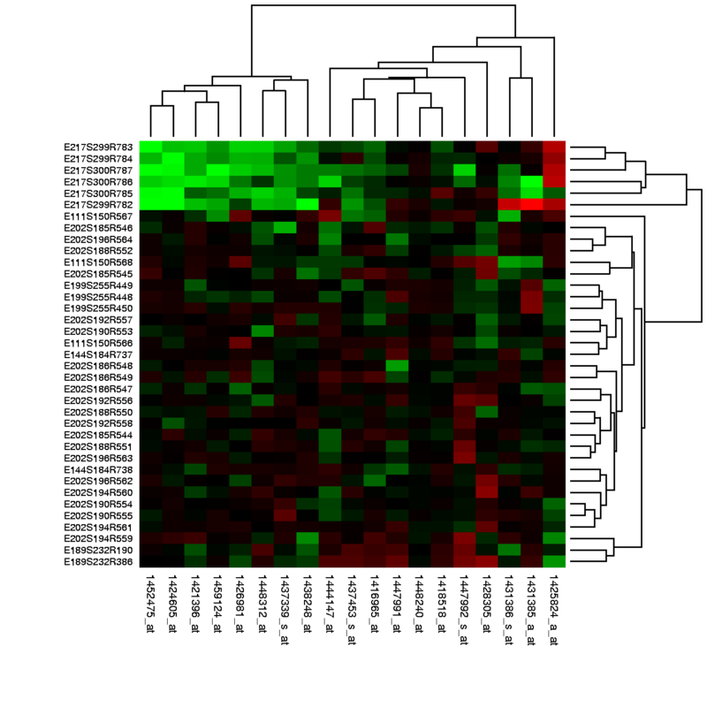
Tools for analyzing RNAseq data in Differential Gene Expression (DGE) studies
María Jesús Herrero, PhD
Circuits Meeting
December 6, 2018

Slide 2
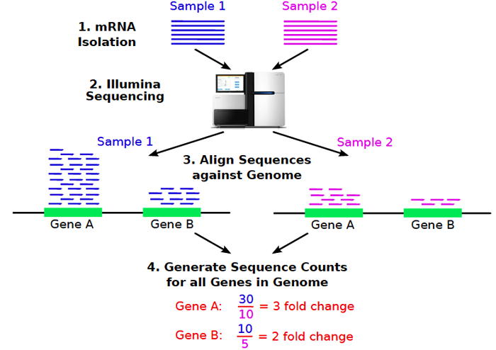
RNAseq steps
Reads
(Girke, 2013)
Notes:
Starting material: Pool? Amplification? RIN?
From RAW data to analyzable set: choices!

Slide 3
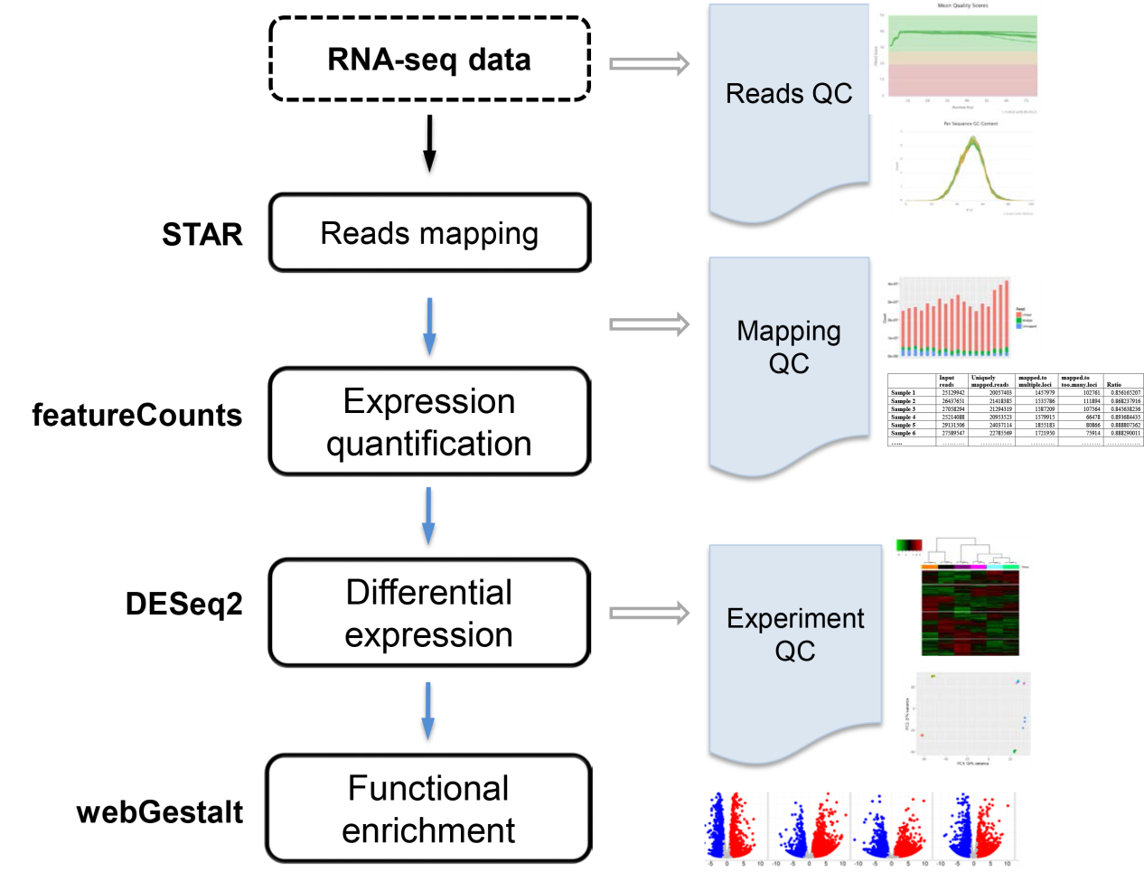
RNAseq steps and Quality Controls
RNA-seq data
1. Align sequences against genome
2. Generate sequence counts for all genes
3. Differential expression accross conditions
4. Functional enrichment
Notes:
The goal is to identify differentially expressed genes across conditions. RNA-seq data are mapped to the reference genome using STAR¹, gene expression are quantified by featureCounts², differentially expressed genes are identified by DESeq2³, and enriched function or pathways are discovered by webGestalt⁴. VANGARD will perform quality check, including raw reads quality (reads QC), mapping quality (mapping QC) and experiment quality (experiment QC) to ensure high quality results. VANGARD will summarize all the results in a report.

Slide 4
RNAseq steps and Quality Controls
1. RNA-seq data
2. Align sequences against genome
3. Generate sequence counts for all genes
4. Differential expression accross conditions
5. Functional enrichment
Notes:
The goal is to identify differentially expressed genes across conditions. RNA-seq data are mapped to the reference genome using STAR¹, gene expression are quantified by featureCounts², differentially expressed genes are identified by DESeq2³, and enriched function or pathways are discovered by webGestalt⁴. VANGARD will perform quality check, including raw reads quality (reads QC), mapping quality (mapping QC) and experiment quality (experiment QC) to ensure high quality results. VANGARD will summarize all the results in a report.

Slide 5
Reads Quality Controls
Notes:
The goal is to identify differentially expressed genes across conditions. RNA-seq data are mapped to the reference genome using STAR¹, gene expression are quantified by featureCounts², differentially expressed genes are identified by DESeq2³, and enriched function or pathways are discovered by webGestalt⁴. VANGARD will perform quality check, including raw reads quality (reads QC), mapping quality (mapping QC) and experiment quality (experiment QC) to ensure high quality results. VANGARD will summarize all the results in a report.

Slide 6
RNAseq steps and Quality Controls
1. RNA-seq data
2. Align sequences against genome
3. Generate sequence counts for all genes
4. Differential expression accross conditions
5. Functional enrichment
Notes:
The goal is to identify differentially expressed genes across conditions. RNA-seq data are mapped to the reference genome using STAR¹, gene expression are quantified by featureCounts², differentially expressed genes are identified by DESeq2³, and enriched function or pathways are discovered by webGestalt⁴. VANGARD will perform quality check, including raw reads quality (reads QC), mapping quality (mapping QC) and experiment quality (experiment QC) to ensure high quality results. VANGARD will summarize all the results in a report.

Slide 7
Galaxy
Notes:
The goal is to identify differentially expressed genes across conditions. RNA-seq data are mapped to the reference genome using STAR¹, gene expression are quantified by featureCounts², differentially expressed genes are identified by DESeq2³, and enriched function or pathways are discovered by webGestalt⁴. VANGARD will perform quality check, including raw reads quality (reads QC), mapping quality (mapping QC) and experiment quality (experiment QC) to ensure high quality results. VANGARD will summarize all the results in a report.

Slide 8
Mapping Quality Controls
Notes:
The goal is to identify differentially expressed genes across conditions. RNA-seq data are mapped to the reference genome using STAR¹, gene expression are quantified by featureCounts², differentially expressed genes are identified by DESeq2³, and enriched function or pathways are discovered by webGestalt⁴. VANGARD will perform quality check, including raw reads quality (reads QC), mapping quality (mapping QC) and experiment quality (experiment QC) to ensure high quality results. VANGARD will summarize all the results in a report.

Slide 9
RNAseq steps and Quality Controls
1. RNA-seq data
2. Align sequences against genome
3. Generate sequence counts for all genes
4. Differential expression accross conditions
5. Functional enrichment
Notes:
The goal is to identify differentially expressed genes across conditions. RNA-seq data are mapped to the reference genome using STAR¹, gene expression are quantified by featureCounts², differentially expressed genes are identified by DESeq2³, and enriched function or pathways are discovered by webGestalt⁴. VANGARD will perform quality check, including raw reads quality (reads QC), mapping quality (mapping QC) and experiment quality (experiment QC) to ensure high quality results. VANGARD will summarize all the results in a report.

Slide 10
Software packages for detecting differential expression: TCC, edgeR, DESeq
Y
TCC
edgeR
DESeq
Lower number of differentially expressed genes
Higher number of differentially expressed genes
Less strict method
Differential gene expression analysis in R:
Steps | TCC | edgeR | DESeq
Statistical modeling | -- | Neg.Bin distribution | Neg.Bin distribution
Differential expression testing | Coupled with edgeR or DESeq | Likelihood ratio test | Exact test
Adjusted P-values | Benjamini-Hochberge FDR procedure False Discovery Rate = FDR = E(Q) where Q is the proportion of the rejected null hypothesis that are erroneously rejected
Main idea -
TCC: Uses a multi-step normalization method (DEGES) to remove data that are potential DEGs before performing the data normalization, very robust and strict
edgeR: Moderates the degree of overdispersion across genes
DESeq: Models the observed relationship between the mean and variance when estimating dispersion
(Seyednasrollah et al., 2013)

Slide 11
Top 30 genes (considering log FC values)
DGE ANALYSIS:
Clusters genes or unique candidate genes
JC36+ | JC38+ | JC37- | JC39- | p.value | lfc | ranking | symbol | Expressed in amygdala?
689.1 | 5952.1 | 0.6 | 3.2 | 0.000 | -10.4 | 1 | Igf2
101.3 | 1933.0 | 0.1 | 1.1 | 0.000 | -10.1 | 4 | Gjb6
190.1 | 1617.3 | 0.2 | 1.0 | 0.000 | -10.1 | 6 | Col6a1
144.0 | 1439.2 | 0.1 | 0.8 | 0.000 | -10.1 | 10 | Gpc3
854.2 | 25627.8 | 1.1 | 18.7 | 0.000 | -10.1 | 12 | Ptgds
177.3 | 784.5 | 0.3 | 0.7 | 0.000 | -9.5 | 15 | Lox
111.1 | 2605.0 | 0.2 | 2.7 | 0.000 | -9.4 | 5 | Avp
12.9 | 1133.7 | 0.0 | 1.0 | 0.000 | -9.4 | 24 | Fgfbp1
11.8 | 1192.5 | 0.0 | 1.4 | 0.000 | -9.0 | 27 | Slc6a20a
117.3 | 613.4 | 0.3 | 0.9 | 0.000 | -8.8 | 25 | Eya2
63.0 | 515.6 | 0.2 | 0.8 | 0.000 | -8.7 | 39 | Slc16a1
198.9 | 637.7 | 0.7 | 1.3 | 0.000 | -8.4 | 18 | EGFP
29.9 | 499.2 | 0.1 | 0.9 | 0.000 | -8.4 | 43 | Laptm5
20.0 | 490.7 | 0.1 | 0.9 | 0.000 | -8.3 | 50 | Osr1
26.2 | 455.5 | 0.1 | 0.9 | 0.000 | -8.3 | 51 | Tenc1
102.3 | 1054.9 | 0.4 | 2.7 | 0.000 | -8.1 | 20 | Col6a2
1769.8 | 2460.6 | 9.7 | 8.0 | 0.000 | -7.9 | 16 | Col3a1
1232.1 | 1550.5 | 7.5 | 5.6 | 0.000 | -7.8 | 9 | Rgs5
8.6 | 346.3 | 0.0 | 0.9 | 0.001 | -7.7 | 100 | Cdh5
127.8 | 64.4 | 0.7 | 0.2 | 0.001 | -7.6 | 101 | RP24-113A5.1
205.6 | 457.3 | 1.4 | 1.8 | 0.000 | -7.5 | 36 | Cd83
338.7 | 293.9 | 2.3 | 1.2 | 0.000 | -7.5 | 38 | Scn5a
160.3 | 926.4 | 1.2 | 4.1 | 0.000 | -7.4 | 22 | Sepp1
50.3 | 533.9 | 0.4 | 2.2 | 0.000 | -7.4 | 40 | Crabp2
181.8 | 1062.8 | 1.4 | 5.0 | 0.000 | -7.4 | 32 | Fcgrt
683.1 | 3261.8 | 5.7 | 15.9 | 0.000 | -7.4 | 21 | H19
17.2 | 427.6 | 0.1 | 1.7 | 0.000 | -7.3 | 77 | Lrrc32
32.4 | 323.6 | 0.2 | 1.4 | 0.001 | -7.2 | 98 | Cd248
603.4 | 2486.4 | 5.6 | 13.7 | 0.000 | -7.2 | 31 | Slc6a13
57.2 | 146.9 | 0.4 | 0.7 | 0.001 | -7.2 | 129 | 2610034B18Rik
To validate experimentally
Igf2: Insulin Like Growth Factor 2
Growth-promoting activity
Fetal development
Inflammation (IL-2 Pathway)
Ptgds: Prostaglandin D2 Synthase
SCN neuromodulator
SCN maturation
Anti-apoptotic in oligodendr.
Male reproductive system
Avp: Arginin vasopressin
Antidiuretic on the kidney
Vasoconstriction
Cognition. Adaptation
Sexual/maternal behavior
Cdh5: Cadherin 5
Cell adhesion
Calcium-dependent
→ Some of these genes as cre-driver? To verify: co-localization with Foxp2 in brain areas and availability of cre-mouse.
→ 5 genes "Syndromic“ in ASD

Slide 12
Experiment Quality Control RNAseq data
Checking data quality:
Principal Component Analysis (PCA)
Volcano plots
Heatmaps
• Compare transcriptomic signatures
→ clusters genes or unique candidate genes.
- Amigo
- David
- IPA
- Genomatix
Cytoscape Apps (e.g. Cluego)
WebGestalt
Associating significant genes: biological meaning:
• Which mechanisms account for the differential transcriptomes?

Slide 13
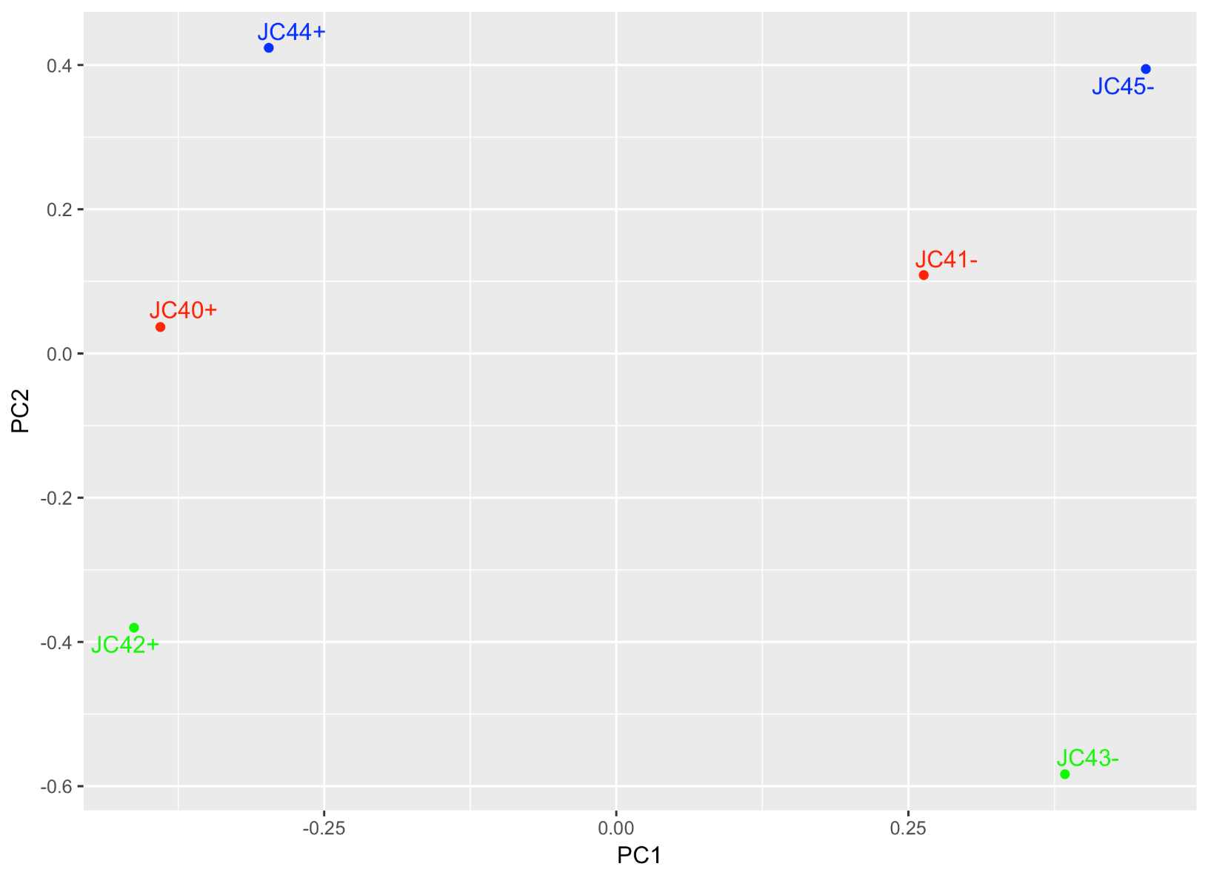
Checking experiment data quality:
Principal Component Analysis (PCA)
Normalization?
COMBAT app for removing
Batch effect
Scripts in R provided under request

Slide 14
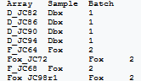
How to use Combat (online)
Merge HTSeq Counts
(Input.file.los.gz)
Input file → upload all files → Run
CLS File creator
(Cls file)
Input .gz file → define classes → download .cls file
(e.g Dbx next Foxp2 next)
Preprocess Read Counts
(Preprocessed.gct file)
Upload input .gct file → .cls file → Run
(It is a kind of normalization)
COMBAT
To create an excel with sample info → save as .txt
(2 files: Combat.get.file plots – similar to QQ plot - and
Preprocessed.combat.gct)
e.g. «sample_information_file.txt»
Upload input preprocessed.gct file → sample.info.txt file → Run
→ Convert Preprocessed.combat.gct to Excel

Slide 15
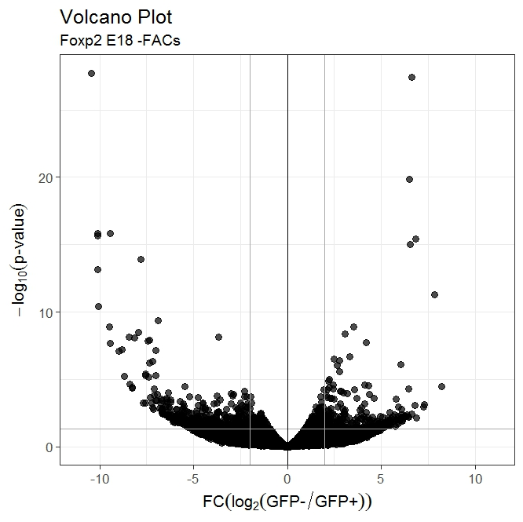
Checking experiment data quality:
Volcano plots
Scripts in R provided under request

Slide 16
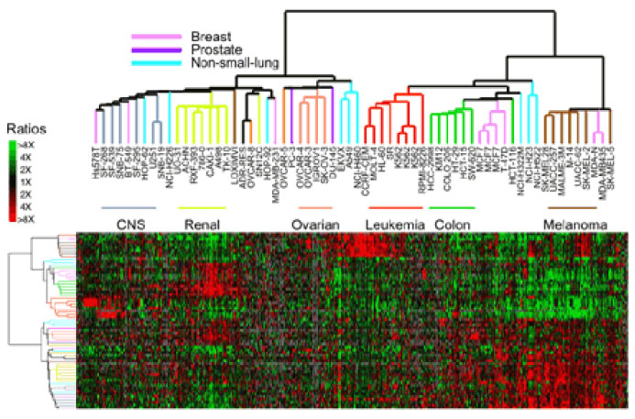
Heatmaps

Slide 17
RNAseq steps and Quality Controls
1. RNA-seq data
2. Align sequences against genome
3. Generate sequence counts for all genes
4. Differential expression accross conditions
5. Functional enrichment
Notes:
The goal is to identify differentially expressed genes across conditions. RNA-seq data are mapped to the reference genome using STAR¹, gene expression are quantified by featureCounts², differentially expressed genes are identified by DESeq2³, and enriched function or pathways are discovered by webGestalt⁴. VANGARD will perform quality check, including raw reads quality (reads QC), mapping quality (mapping QC) and experiment quality (experiment QC) to ensure high quality results. VANGARD will summarize all the results in a report.

Slide 18
Info Gene Ontology
1) Candidate gene approach
Biological process
Ensembl
Amigo
David
Others
Molecular Function
Cellular component
2) Clusters gene approach → RNAseq
David
Cytoscape Apps (e.g. Cluego)
IPA (License available at Children’s)
Genomatix (Not for free)
Agrigo
WebGestalt
Others

Slide 19
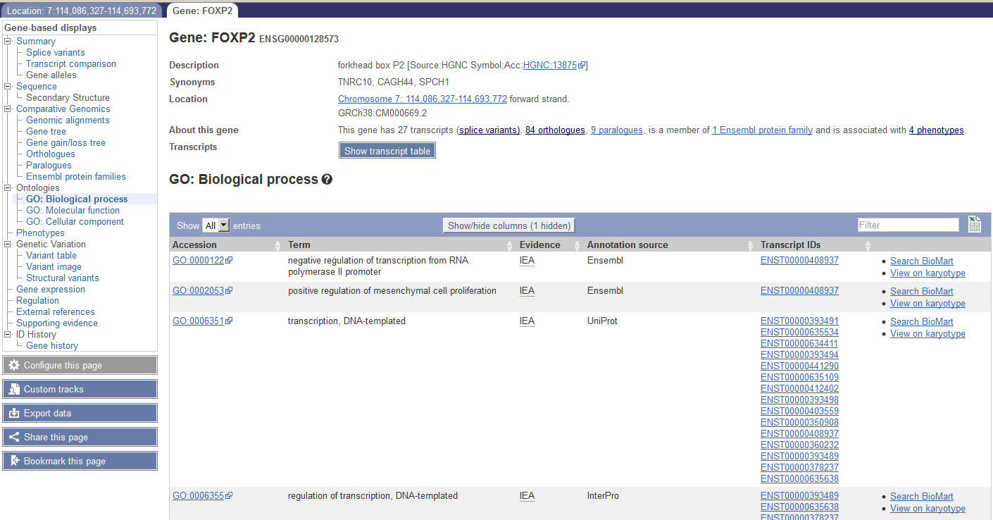
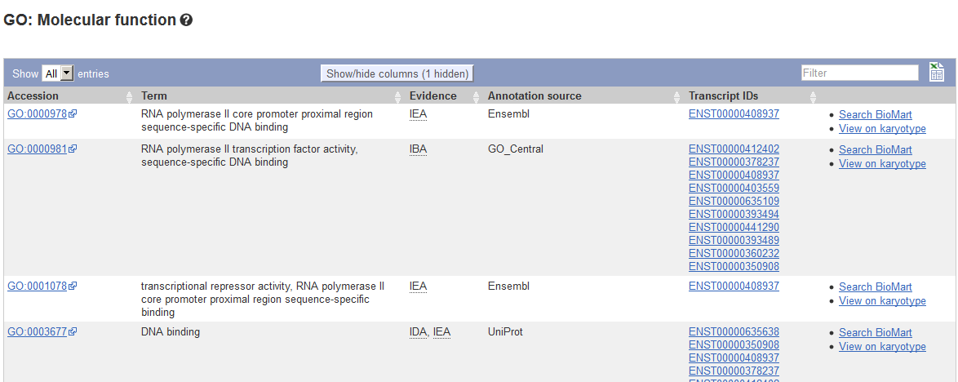
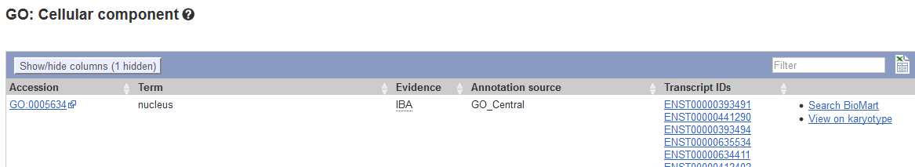
1) Candidate gene approach Ensembl GO:

Slide 20
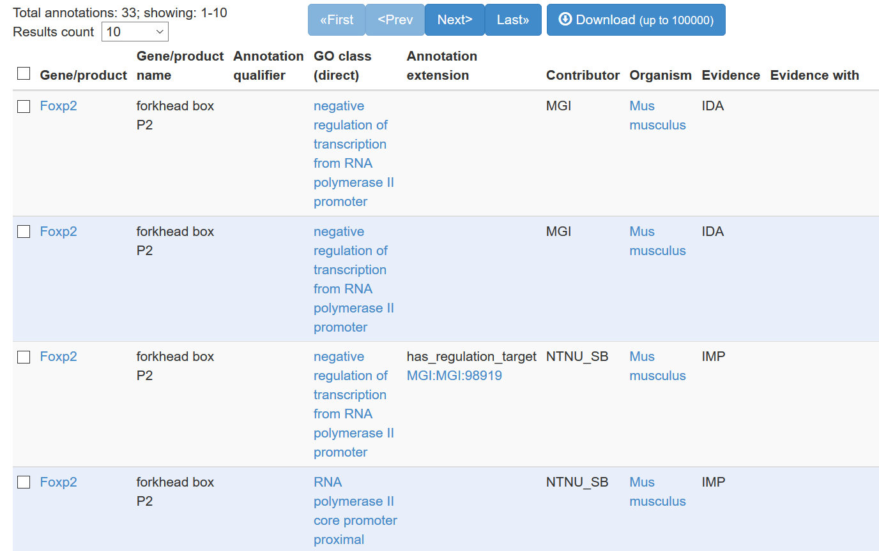
1) Candidate gene approach: AmiGO

Slide 21
2) Multiple genes approach - David

Slide 22
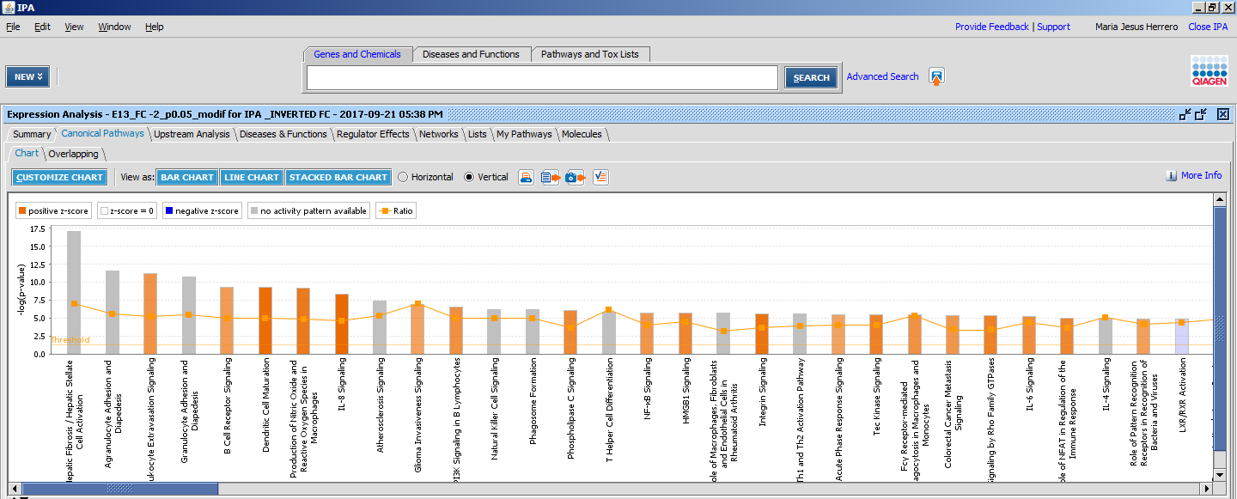
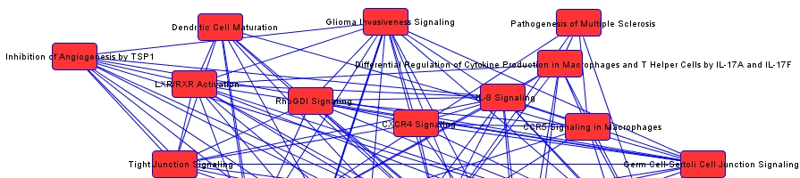
2) Multiple genes approach - IPA

Slide 23
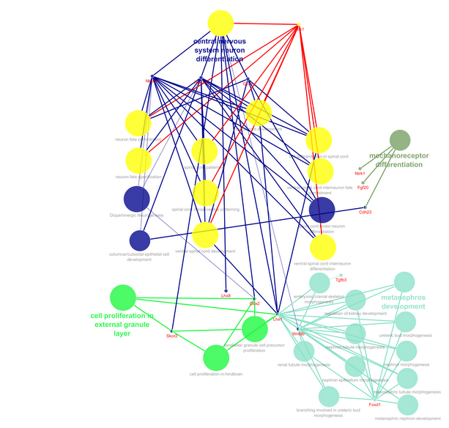
2) Multiple genes approach – Cytoscape - ClueGO

Slide 24
1) Descriptive validation of RNAseq (level + topography of expression)
Validation of RNAseq
rt-qPCR ( attention to the isoforms !! )
Micro-arrays CDs
Ish
Blots
Genetic methods: transgenic prom-Candidat+ reporter (GFP, etc).
2) Functional validation (mechanisms)
3) Coherence with bibliography

Slide 25

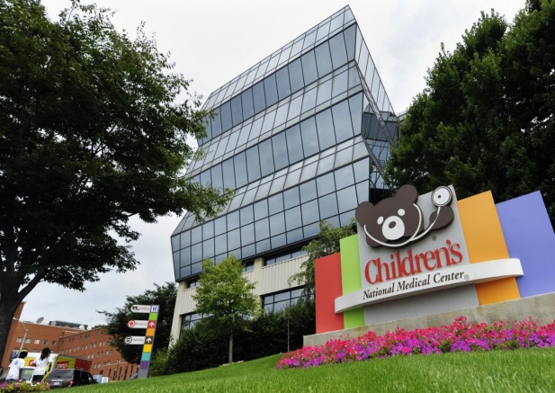
Thank you!
Mentor
Joshua Corbin, PhD
Corbin Lab
Li Wang, PhD
Meredith Goodrich
David Hernández-Piñera
Heidi Matos, PhD
Luke Tsai
Saarthak Sethi
Albino Folcarelli
Triplett Lab
Dayu Lin Lab
Julieta Lischinsky, PhD
Neuroscience Research Center
Kazue Hashimoto-Torii, PhD
Toru Sasaki, PhD
Aiesha Basha
Bioinfo Core
Payal Banerjee
Cancer and Immunology Research
Christopher Lazarski, PhD
Penn State College of Medicine
Yuka Imamura, PhD
Yale University School of Medicine
Abha Gupta, PhD
Catherine Sullivan
Takashi Yamaguchi, PhD
Grant Funding
NIH/R01-DA020140-12A1
Smith Lab
GW
Nathan Smith, PhD
Yangzi Zhou

Slide 26
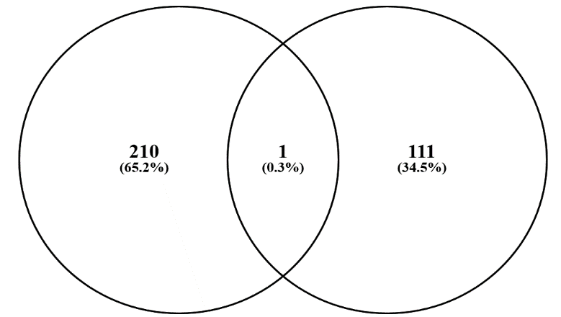
Other tools of interest
Foxp2
Dbx1
Venn diagram:
http://bioinfogp.cnb.csic.es/tools/venny/
Conversors ID to ENS, MGI..
- MGI (mouse): http://www.informatics.jax.org/batch
- David (different species): https://david.ncifcrf.gov/

Slide 27
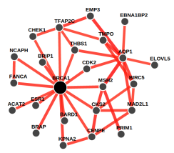
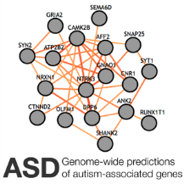


GIANT | GIANT is a web server that provides an interactive interface to all 144 human tissue networks through multi-gene queries and sophisticated network visualization. Researchers can query by individual genes or by gene sets of interest to analyze tissue-specific gene functions and interactions. Multi-tissue view allows for rapid examination of the tissue-specific rewiring of functional connections across diverse tissues. GIANT also provides a full NetWAS implementation, allowing users to upload gene-based association P values to receive NetWAS association scores. http://giant.princeton.edu
 | Autism spectrum disorder (ASD) is a major neurodevelopmental disorder with a strong genetic basis. Yet, currently, we only know a small fraction of potentially causal genes. ASD@Princeton presents a genome-wide prediction of autism-associated genes described in the context of a human brain-specific gene interaction network. Created by the Laboratory for Bioinformatics and Functional Genomics in the Lewis-Sigler Institute for Integrative Genomics at Princeton University, this dynamic web-interface also contains cellular pathways, spatiotemporal brain signatures, and CNV intervals linked to ASD. http://asd.princeton.edu
FNTM | Functional Networks of Tissues in Mouse (FNTM) provides biomedical researchers with tissue-specific predictions of functional relationships between proteins in the most widely used model organism for human disease, the laboratory mouse. Users can explore FNTM-predicted functional relationships for their tissues and genes of interest or examine gene function and interaction predictions across multiple tissues, all through an interactive, multi-tissue network browser. FNTM makes predictions based on integration of a variety of functional genomic data, including over 13,000 gene expression experiments, and prior knowledge of gene function. FNTM predicts tissue-specific functional relationships in 200 tissues, does not require any registration or installation and is freely available for use at http://fntm.princeton.edu
 | WISP (worm integrated in specific contexts) provides an interface to the 203 tissue- and cell-type specific functional networks spanning all major tissue systems in worm developed by the Laboratory for Bioinformatics and Functional Genomics in the Lewis-Sigler Institute for Integrative Genomics at Princeton University. Users can query the networks, investigate gene set enrichments in the resulting subnetworks, and compare subnetworks across multiple tissues

Slide 28
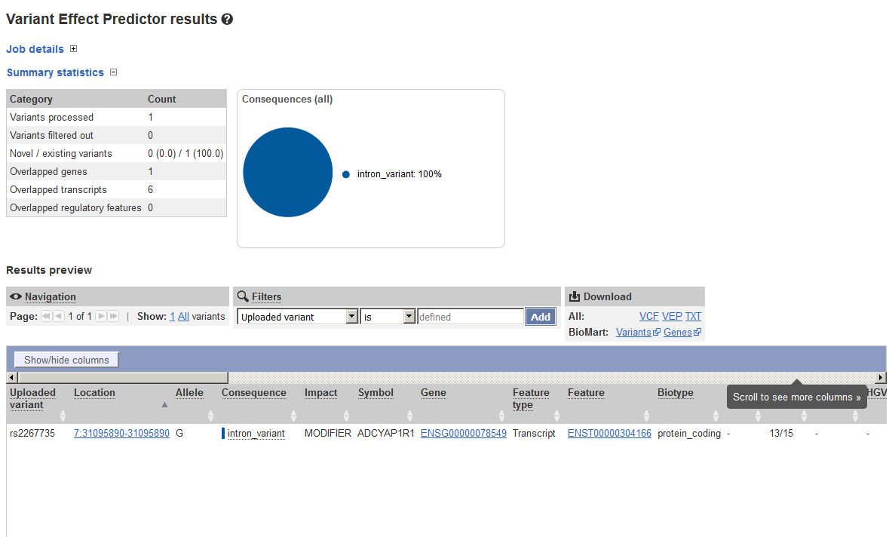

Slide 29
Info gene in other genome browsers
Gene NCBI: https://www.ncbi.nlm.nih.gov/gene/4885
UCSC??
Good to explore options!
Notes:
Genecards
http://www.genecards.org/

Slide 30
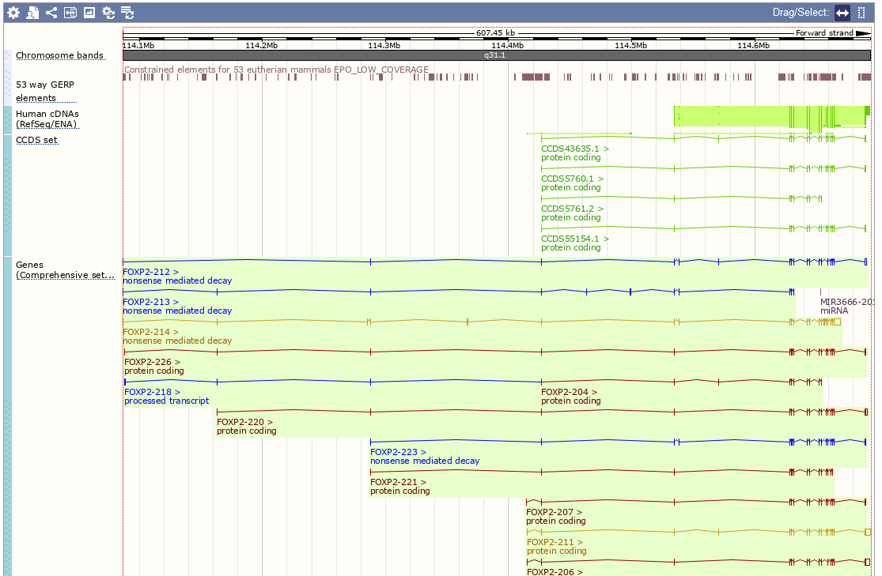
Region in detail
GERP elements?

Slide 31
Popular data browsers:
Ensembl
http://www.ensembl.org/index.html
UCSC
https://genome.ucsc.edu/cgi-bin/hgGateway
NCBI
Genomatix (Not for free!): human-curated = human errors + robot-detection keyword!
https://www.genomatix.de/
Use several!
(coordinates, sequences, identifiers vary)

Slide 33
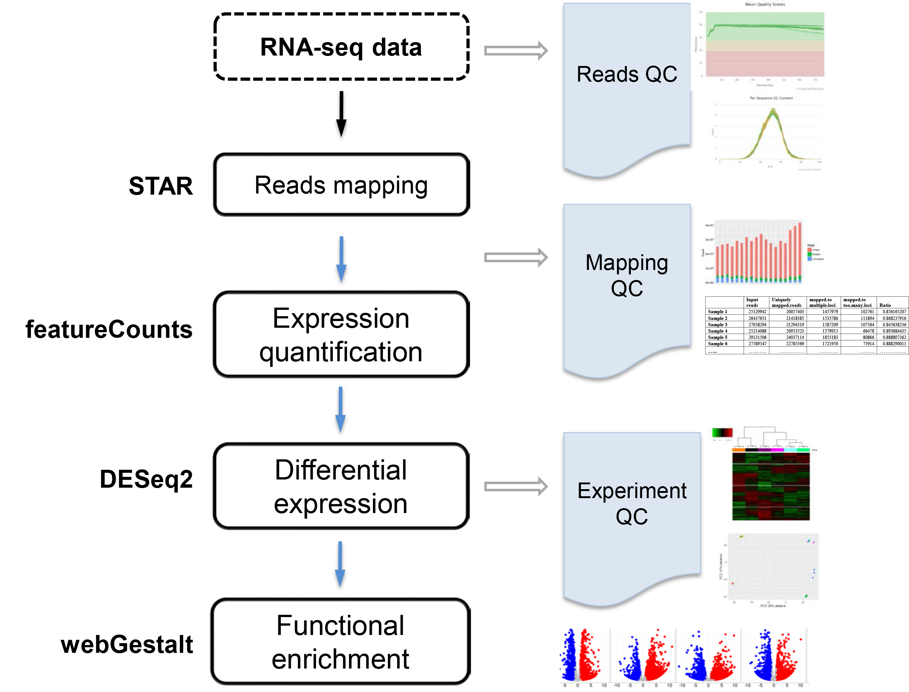
RNAseq pipeline
Notes:
The goal is to identify differentially expressed genes across conditions. RNA-seq data are mapped to the reference genome using STAR¹, gene expression are quantified by featureCounts², differentially expressed genes are identified by DESeq2³, and enriched function or pathways are discovered by webGestalt⁴. VANGARD will perform quality check, including raw reads quality (reads QC), mapping quality (mapping QC) and experiment quality (experiment QC) to ensure high quality results. VANGARD will summarize all the results in a report.

